Slide 1


Slide 2
Step 1
Getting Started

Slide 3
Marketing Objective
The marketing goal of your blog post
Gain more than 5200 followers in January

Slide 4
KPI
Average followers of blog posts gained end of January

Slide 5

Target Persona
Background and Demographics | Target Persona Name | Needs
Category: Girls Age: from 20 to 35 Education: University Occupation: low-income female employee (unemployed) Family life: medium The nationality is Arabic Common features: Having a profitable job | Amal | The means that helps her to reach Independent job from home Money to help her meet her needs
Hobbies | Goals | Barriers
Sports Draw Self development reading Hobbies | Independent work from home You get a good education You get high wages | Don't want mixed-sex work for men (dogmatic)? You did not find the right direction You don't know which direction to follow How to access digital jobs

Slide 6
Step 2
Write a Blog Post

Slide 7
What is the theme and framework of your blog post?
Provide a brief summary of your blog post including the following:
Select a theme for your blog post:
Why have you decided to take the Digital Marketing Nanodegree Program?
I want to take advantage of the opportunity to learn with Udacity, I see that it provides the best flexible and applied learning materials
2. What is the framework of your blog post? Frame SCQA
Situation: I want a job that matches my skills.
Complexity: Time, the ideological concept (non-promiscuity) of the digital world
A momentum of ideas and information, and which paths to follow
Question: What are the best platforms I can trust?
Answer: nano digital marketing program.

Slide 8
Write a blog post, with the theme you’ve chosen from the options above, in the space provided below.
https://bit.ly/3lM9yNR

Slide 9
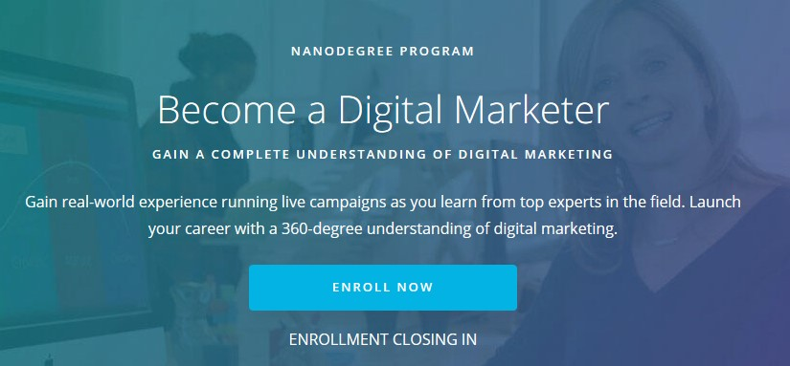
Blog Post
Get a job and a high salary from your home in the digital marketing field with major international companies. Ease and flexibility of daring gives you the opportunity What are you waiting for? Join now through this link https://bit.ly/3lM9yNR

Slide 10
Step 3
Craft Social Media Posts

Slide 11
Summary
Facebook
is the largest and largest social network, with 2.4 billion monthly active users, and has a variety of features and use cases. Any company can use to share text, video, images, live video and stories, there is a set of special advertising options.
Twitter
is the community speaker, which is a social messaging service where users are limited to 280 characters of text to be reposted among its audience. As an important and updated source for news of current events in the world, the platform is best used by companies to join popular conversations and communicate with customers individually.
Instagram
has its main user base is a community focused on sharing visual content like photos, short forms, and long videos. It is considered the online mall of today's generation. According to Instagram, 60% of people surveyed said they found new products there. This is because companies are able to visually share and market their offerings.

Slide 12
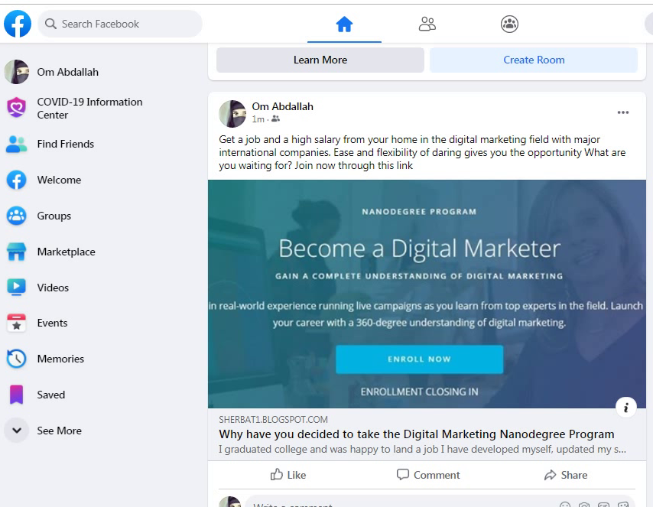
Platform 1 and Post
Facebook is the largest and largest social network, with 2.4 billion monthly active users, and has a variety of features and use cases. Any company can use to share text, video, images, live video and stories, there is a set of special advertising options.

Slide 13
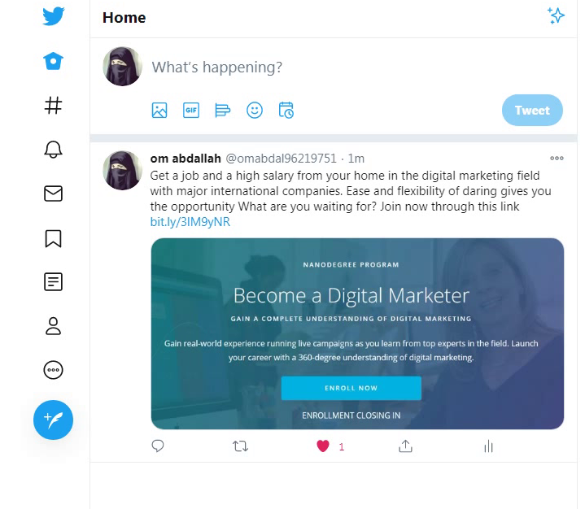
Platform 2 and Post
Twitters the community speaker, which is a social messaging service where users are limited to 280 characters of text to be reposted among its audience. As an important and updated source for news of current events in the world, the platform is best used by companies to join popular conversations and communicate with customers individually.

Slide 14
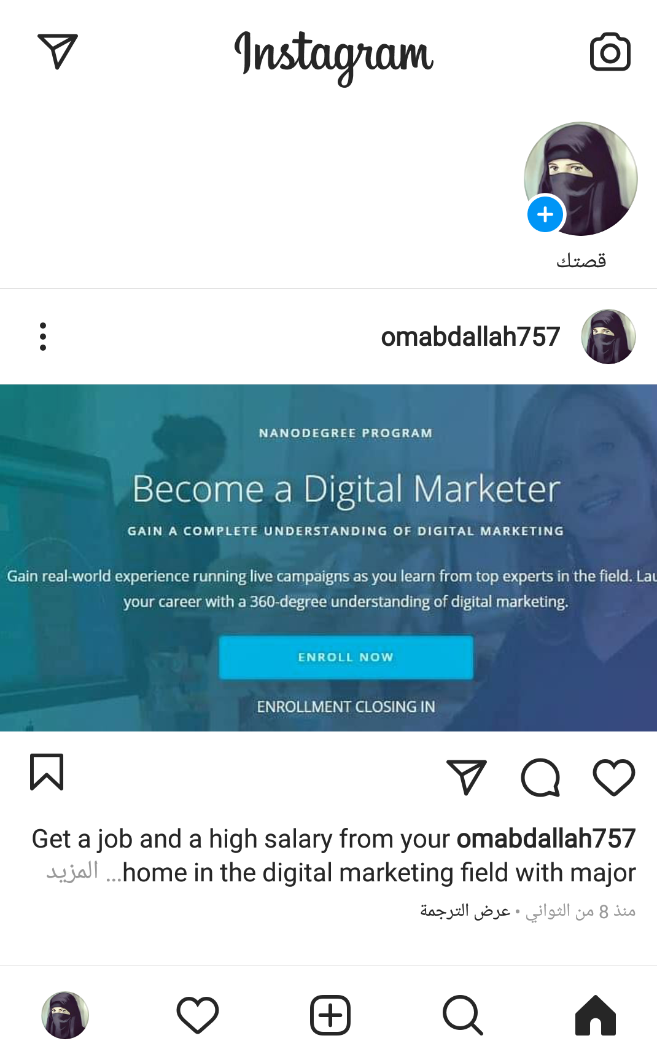
Platform 3 and Post
Instagram has its main user base is a community focused on sharing visual content like photos, short forms, and long videos. It is considered the online mall of today's generation. According to Instagram, 60% of people surveyed said they found new products there. This is because companies are able to visually share and market their offerings

Slide 15
Extra Credit

Slide 16
Extra Credit: Post Online & Share Your Results
Put your social media plan to action and promote your blog on the platforms you chose. Share your results in the table below.
Platform | Traffic | Likes | Shares | Comments | Notes
Blog | 6000 | 3000 | 800 | 3500 | Read comments
Social Facebook | 3300 | 1600 | 450 | 1100 | Read comments
Social Twitter | 2000 | 2200 | 350 | 975 | Read comments
Social Instagram | 2700 | 2000 | 312 | 635 | Read comments

Slide 17
Extra Credit: Analysis
What would you do differently based on your results?
What other topics might you feature on your blog and in social?
What would you do differently based on your results?
What other topics might you highlight on your blog and social media sites?
Checking the measurement of impact, traffic statistics, liking and participation, as well as comments and research in the common content, and through the mortar I will always offer them the best way to choose and master the display of its importance, which makes him have a constant desire to wait for the blog posts

